Slide 1
Requirements and Specifications
Document
of AWS billing automation system
Hayato Toyoda

Slide 2
Introduction
Let me get straight to the point, this project is still on its way. Therefore, I am going to introduce what that is supposed to be at first, and then I will explain the problem on the system which I made.

Slide 3
Requirements
To make a web application to meet the following requirement;
From one year ago to today, pulling the cost information of 10 AWS account throughout AWS SDK for python, Boto3.
Putting those data to AWS Dynamo Data Base(DDB) at “Service Integration” account, in order to store them forever.
Going back to the oldest month stored at DDB, export those as Excel File to the terminal executing this application.
However, this cost information shows the following things;
The monthly detail fees in units of a service.
The monthly total fees at each account.
The monthly total fees of all 10 accounts.
Accumulated fees till now thorough all 10 accounts.

Slide 4
Specifications of the structure
The user of the website follows the steps below to download an Excel file:
Accessing the Website: The user navigates to the statically hosted website via their web browser.
Clicking the Download Button: The user clicks on a specific button on the website (e.g., a "Download" button).
Triggering the API Gateway: This button click triggers an API request in the background via the API Gateway.
Activating AWS Lambda: The API request then prompts the activation of a specific AWS Lambda function.
Executing the Lambda Function: This Lambda function performs the specified operation (e.g., data collection or analysis), generating an Excel file as a result.
Downloading the Excel File: Finally, the generated Excel file is downloaded to the user's device. This typically involves the web browser automatically initiating the download and saving the file in a directory specified by the user.
Through this process, the user of the website can simply click a specific button to execute necessary back-end operations and download the resulting Excel file.

Slide 5
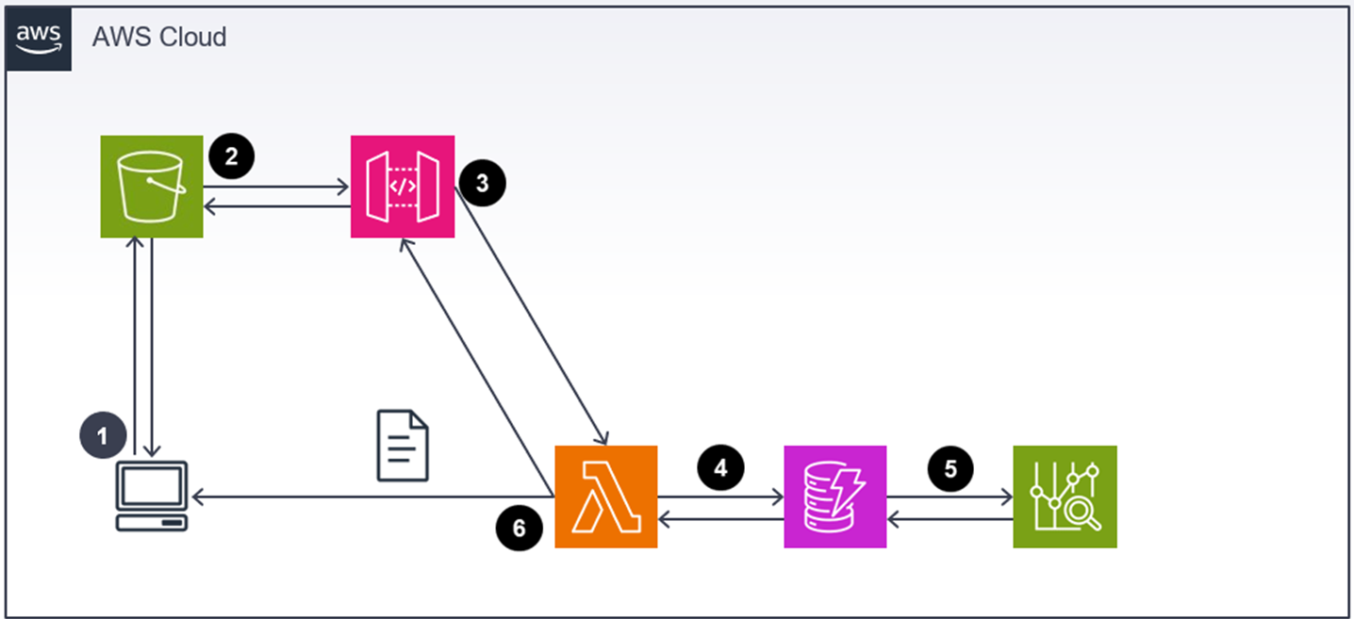
Dialog of this system
End point of S3: http://cost-explorer-for-toyoda.s3-website-us-west-2.amazonaws.com/

Slide 6
Dialog of this system for local env
End point of S3: http://cost-explorer-for-toyoda.s3-website-us-west-2.amazonaws.com/

Slide 7
Specifications of Python on Lambda
The main processing steps of this Python script are as follows:
AWS Connection Initialization: This script initializes connections with specified AWS clients, as defined in the client_names list and both aws access key id and aws secret access key listed on the script directly.
Billing Information Retrieval: It retrieves billing information from each AWS client. The retrieval is for unblended costs per service over a specific period (the past one year). This information is obtained from AWS using the get_cost_and_usage function.
Utilization of DynamoDB: The retrieved billing information is stored in AWS's DynamoDB. The script first checks whether the latest billing information exists in the DynamoDB table. It only calls AWS's Cost Explorer API to fetch new information if it does not exist, thus preventing unnecessary API calls.
Excel Output of Results: The billing information obtained from DynamoDB is output to an Excel file.

Slide 8
The problems with the code for Lambda
Now you have to modify the code for local env, in order to make that work at Lambda. There are still two problems. The place where the excel data store; On Lambda you can’t make and edit the csv file on local file, and so you should store that at temporal directory.
The conversion of the file format from csv to binary data; Through API, you cannot send the file as csv file from Lambda to local file. Therefore, you should change them as a binary data. These two above things are the problem you have to debug.

